Slide 1

Superstore Sales and Profitability Analysis
Somagutta Pavan Kumar Reddy
Apply ID:APPLY_172754857166f84c9ba1345
Dhanalakshmi Srinivasan University
Computer Science Engineering(AI&DS)
3rd year

Slide 2

PROBLEM STATEMENT
The dataset contain information about sales,customer segments,geographic regions, and product categories, and regional preformance.The problem statement should focus on understanding these dynamics to improve business strategies and decision making

Slide 3
This project analyzes a comprehensive retail dataset from a superstore, focusing on sales performance, profitability, and operational efficiency across various dimensions. The dataset includes detailed records of sales transactions, customer segments, product categories, and geographic distribution within the United States.

Slide 4

WHO ARE THE END USERS?
Primary Users:
Store Managers and Regional Directors
Sales and Marketing Teams
Category Managers
Supply Chain Managers
Business Development Executives
Secondary Users:
Finance Teams
Customer Service Representatives
Inventory Managers
Logistics Coordinators

Slide 5

Technology Used
python
pandas
matplotlib
numpy

Slide 6
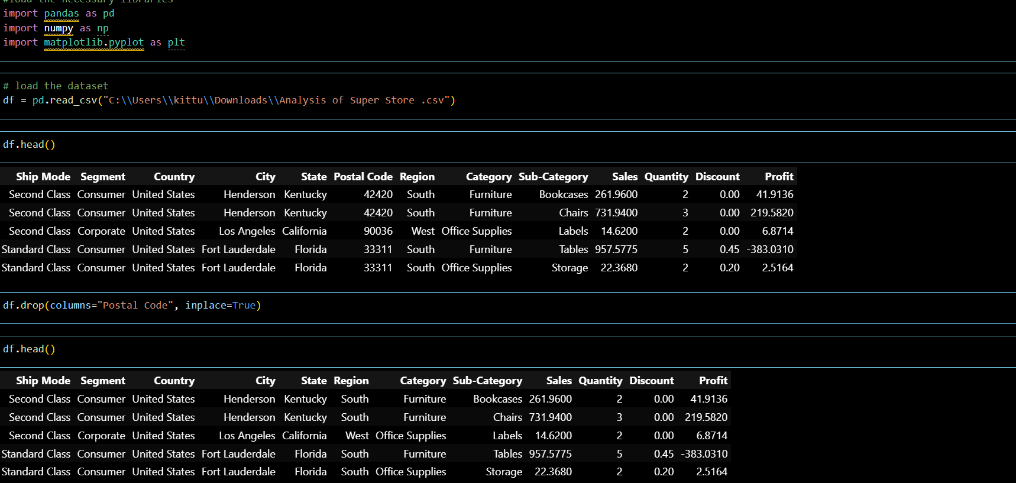
RESULTS
In this code first we imported the important liberious for data analysis. After we load the dataset after we can able to see the data.
now we start the data cleaning process by removing the data of postal code which is not required for our project.
Demo Link

Slide 7
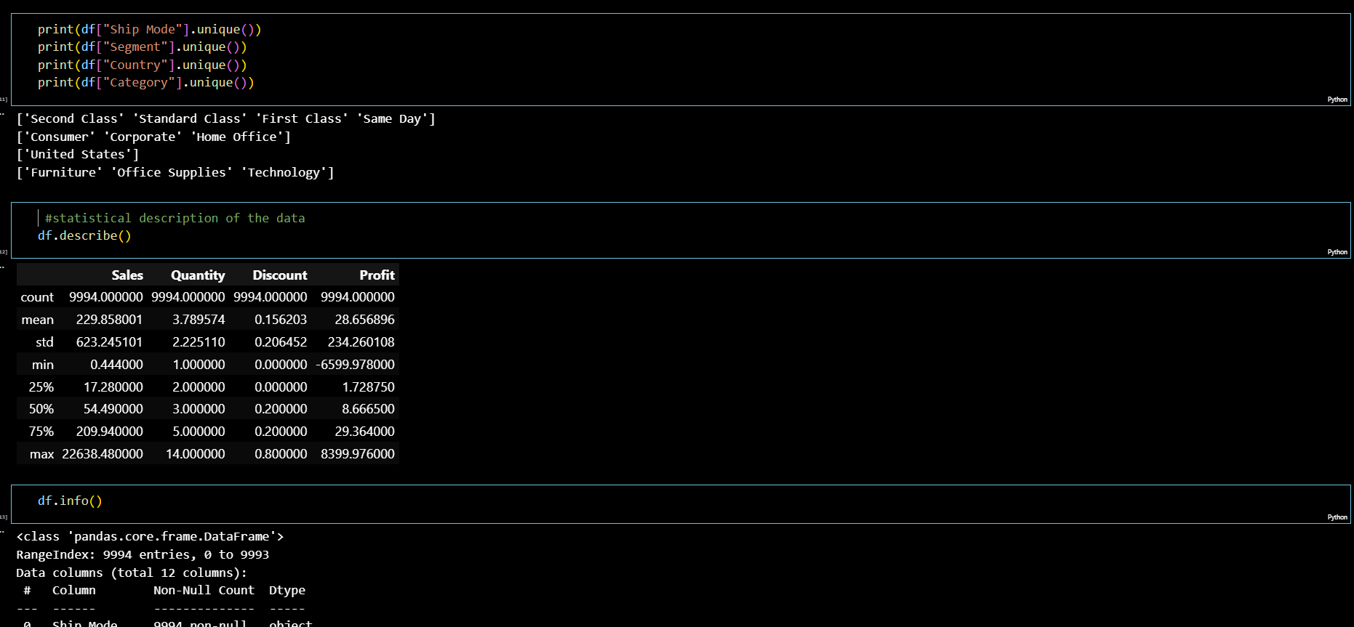
RESULTS
Here we print the unique identies of dataset(shipmode,segment,country,
category)
After statistical description of the data we can undestand the stats of the data
In this code we use info which gives total infomation about given dataset

Slide 8
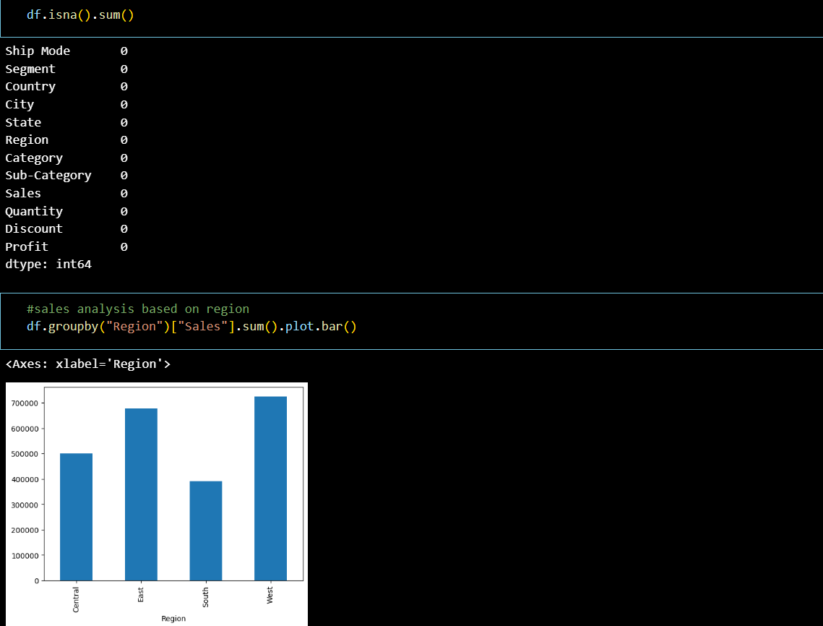
RESULTS
In this code we analysis the sales of the dataset using data visualization(bar )
Here the can able to see the four bar with there levels.

Slide 9
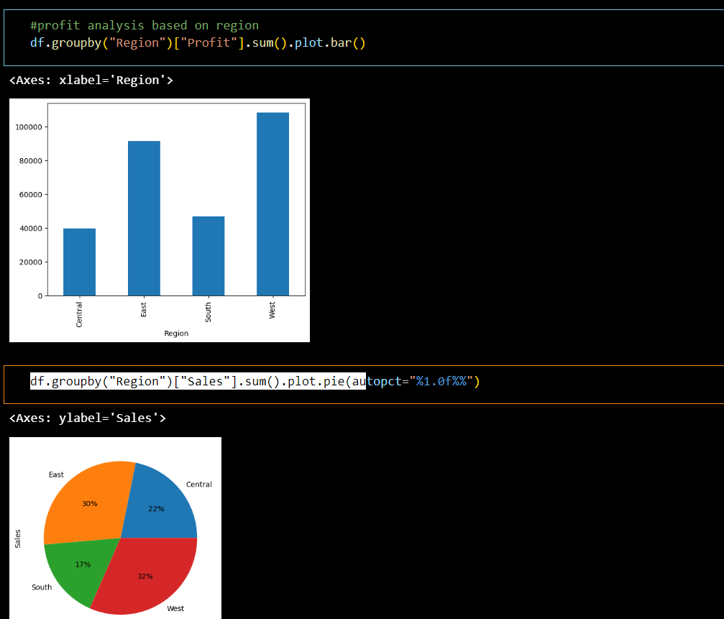
RESULTS
Here we are showing the profits in bar
the max.profit get by west with above the 100000
Here we use pie chart to repesent the sales of the each
In this pie chart we can able to under stand the pesentage of sales happend.

Slide 10
Thank you
.
.

